Slide 1
AWS SMP (Scalable Mortgage Platform)
Group Number # 8
Suresh Vodapally
Pradeep Bejugam
Venkat Kodali
Srinivas Mamidala
Viswakanth Ankireddi

Slide 2



Problem Statement
Mortgages are complicated
BUT
Mortgage software should not be
 | Calyx Point | Turnkey Lender | Elli Mae
Customer Management
Online loan application
Electronic Signature
Compliance management
Document Management
Audit Trail
Closing documents
Electronic Applications
Loan Origination
Commercial Mortgages
Pre-Qualification
Amortization Schedule
Pipeline Management
Refinance Management
Usability
Total Cost of Ownership
Meeting Requirements
Application Support
Administration
Product Direction
Servicing Industry
Organization size
Is there a self service, inexpensive, reliable, scalable Loan PoS application with an accelerated decision !!!!

Slide 3
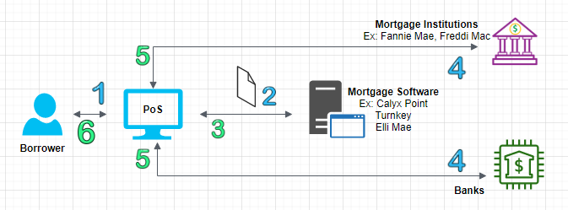
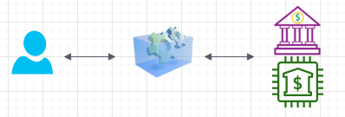
AS IS
PROPOSED SOLUTION
Many Manual touch points – Delay in relay
Data distribution across multiple systems
Trade off across Usability / TCO / Customer satisfaction
Support / Administration / Market size
Self service, automated application
Data in single location, secured
Modernization, Operation and Maintenance simplicity – by removing time / middle men / in-efficiencies

Slide 4
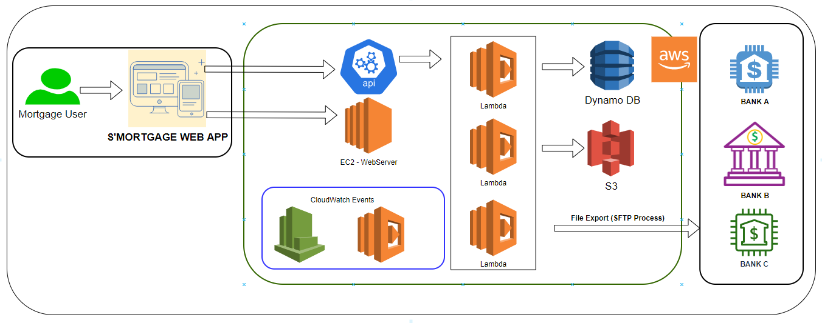
HOW DID YOU CREATE IT?
Lambda function(s) creation & Integration
EC2 webserver instance
Dynamo DB and S3 integration
Integration between UI and Application Services (AWS)
Cloudwatch and SNS interaction for notifications

Slide 5
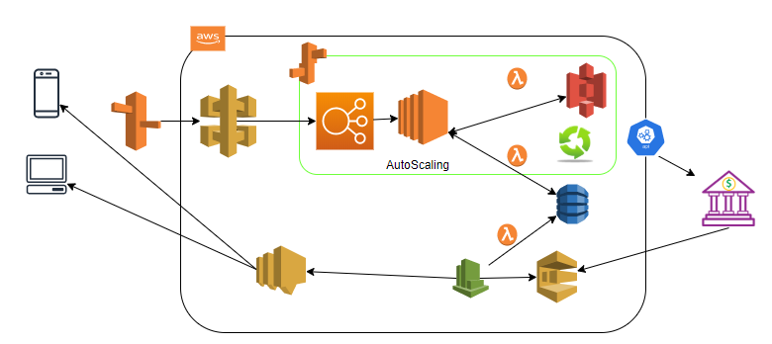

THE PATH FORWARD
Get Credit report from external agencies
Calculate BASEL II financial parameters
Analyze / evaluate and determine customer score
based on customer score - Determine best lender / communicate back to User for next steps
DocuSign Integration

Slide 6
DEMO

